Slide 1
A Taste of Fisheries Science
Dr. David Keith and Dr. Heather Bowlby
Fisheries and Oceans, Canada

Slide 2
Structure of this Module
Reading assignment: provided at the end of each session
Group discussion on the reading: 5-15 minutes
Lecture – ~30 minutes
Coding exercise: ~5 minutes; R code provided
Interpretation from coding exercise: 1-2 page response to a question(s)
Notes:
Blue box identifies in-person topics. Others are done outside of the module time.

Slide 3
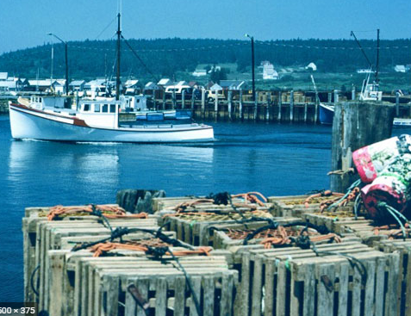
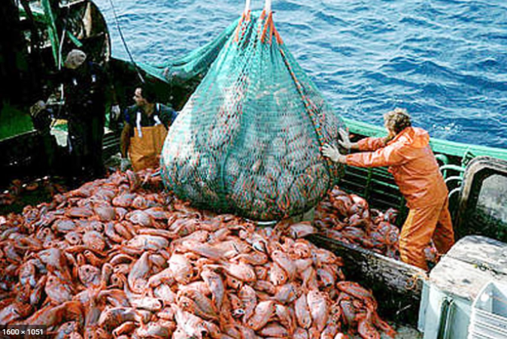
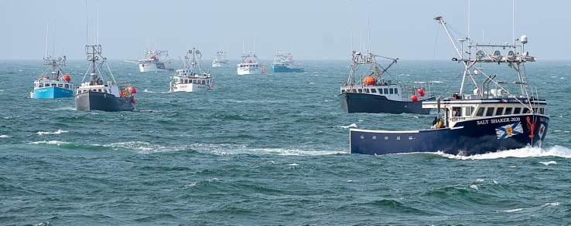
What Makes Fishery Science Unique?
Life History
Age, Reproduction, Survival
Abundance
estimation, indicators, sampling
People
Behaviour, Effort, Socioeconomics
Estimation
non-linear equations, integrated analyses
Future Prediction
Environmental response, mortality
Management
Reference points, status, harvest advice
Notes:
Four lecture topics are identified by red boxes
- People is in bold because there are direct implications of the science on the people that it impacts.

Slide 4
Speak the Language
Gough & Kenchington 1995.
A Glossary of Fisheries Science
Stock
Population
Biomass
Selectivity
Density dependence
Cohort
F
Catch Composition
U
M
S
Age Structure
CPUE
Notes:
Why is this critical for stock assessment? I contend that unlike ecology, the terminology used in fisheries science has specific definitions and these matter when trying to assess a stock. For example:
Is a stock the same as a population? The answer to this will tell you if emigration and immigration can be ignored in your assessment model.
Does a cohort describe biomass?
Is catch composition the same as age structure? No – the catch composition depends on the age structure, but is modified by selectivity
How is F related to U; how is S related to M? Fishing mortality and exploitation are not synonymous and we will tell you why.

Slide 5
Life History Theory
An exceptionally brief introduction
Notes:
Discussion with the group.

Slide 6
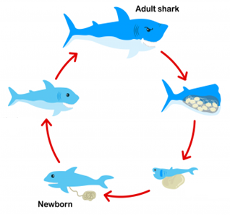
Population Dynamics
Mathematics used to represent the size and age composition of a population, based on life history rates.
Four key processes:
Birth, death, immigration, emigration
Life History Rates
Survival [mortality]
Maturity and Reproduction
Equilibrium Assumptions
To estimate rates
Theoretical Ideas
E.g. density dependence (Spawner-recruit relationships)
Reproductive rate
Fecundity, maturation
Survival:
juvenile to adult
Notes:
Question: Why might it matter if a stock boundary is smaller than a population?

Slide 7
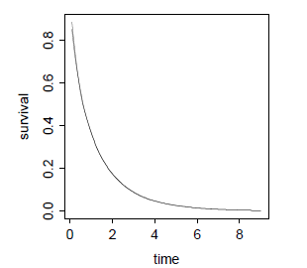
Survival and Cohorts
Survival is multiplicative!!! Whether you are alive now depends on whether you were alive up to now
 | 2001 | 2002 | 2003 | 2004 | 2005 | 2006
age5 |  |  |  |  |  | 37
age4 |  |  |  |  | 45
age3 |  |  |  | 55
age2 |  |  | 67
age1 |  | 82
age0 | 100
Example: annual survival rate of 82%
Question: would you expect a sample
from the population in 2004 to have
these same abundance values?
Notes:
Code will include example of exponential decline in abundance with age
Remember to detail why this can be forgotten – often parameters estimated in log space (becomes additive) vs. in natural scale (needs to be multiplicative). Going back and forth between the two can do your head in.

Slide 8
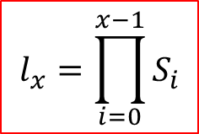
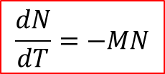
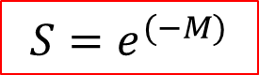
Survival and Mortality
Survival example: Age0*0.82=Age1; Age1*0.82=Age2 …
This is an annual rate, describing changes in population size
Mathematically:
BUT we are actually concerned with mortality (M)
Survival is related to mortality by:
When studying mortality we are interested in rates of change
M is more convenient to express as an instantaneous rate
Mortality is a continuous process.
$$l_{x}=\prod_{i=0}^{x−1}{S_{i}}$$
$$S=e^{(−M)}$$
$$\frac{dN}{dT}=−MN$$
Notes:
Mention that we look at rates of change but then need to put this in context of actual abundance

Slide 9
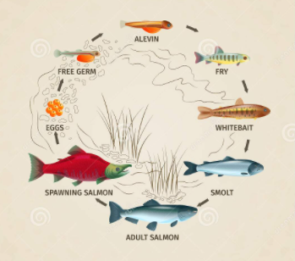
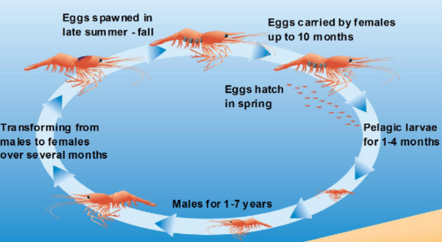
Maturity and Reproduction
Semelparous
Iteroparous
Other Life Cycles

Slide 10
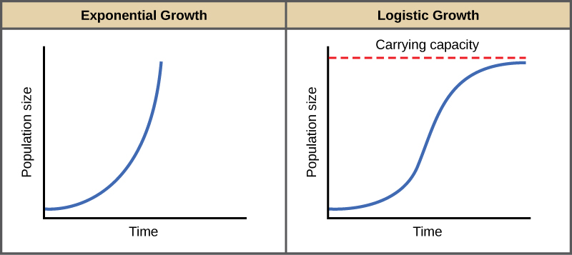
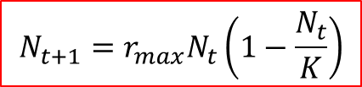
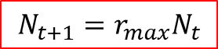
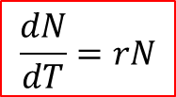
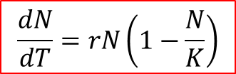
How Do Populations Change in Size?
Populations do not grow without bound.
Density dependence
How fast a population grows is related to how close it is to its ‘maximum’ size
$$\frac{dN}{dT}=rN$$
$$\frac{dN}{dT}=rN\left(1−\frac{N}{K}\right)$$
$$N_{t+1}={r_{max}N}_{t}$$
$$N_{t+1}={r_{max}N}_{t}\left(1−\frac{N_{t}}{K}\right)$$

Slide 11
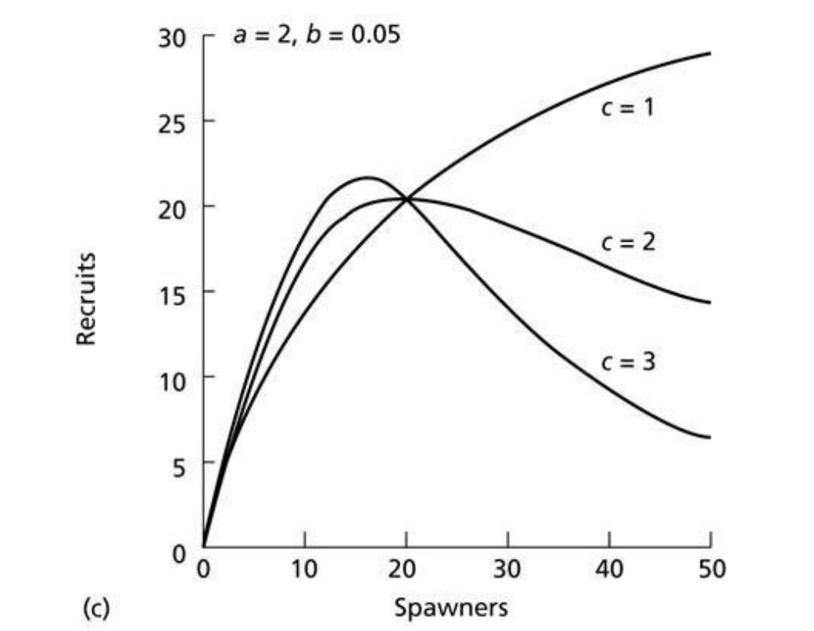
Stock-Recruitment Relationships
Number of offspring is related to the number of parents
Required to describe reproductive output of a year-class
Typically, the youngest ages of a population are very hard to sample
We see animals that have ‘recruited’ to the fishery
Expectation is that young fish experience density-dependent mortality
Year class strength (recruitment) scales relative abundance and is critical for reference points
Linear
Beverton-Holt
Ricker

Slide 12
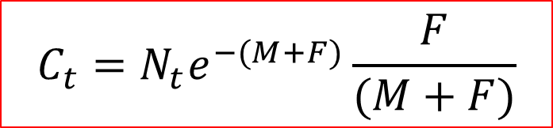
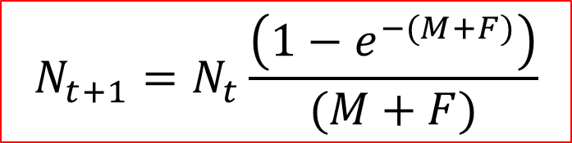
How Does Fishing Come In?
Z = M + F
U = e^{-F}
$$N_{t+1}=N_{t}\frac{\left(1−e^{−(M+F)}\right)}{(M+F)}$$
Exploitation Rate
Baranov Catch Equation (1918)
$$C_{t}=N_{t}e^{−(M+F)}\frac{F}{(M+F)}$$
Key Idea: fishing mortality and natural mortality are proportional to abundance

Slide 13
Simple as 1, 2, 3…..
Take information about the animal’s life history and build a model to describe it
Link the sources of data that you have (e.g. catch at age) and use the model to estimate rates (e.g. survival, reproductive output)
Estimate total mortality from these rates and account for the proportion that comes from fishing!
HOW can this possibly go wrong???

Slide 14
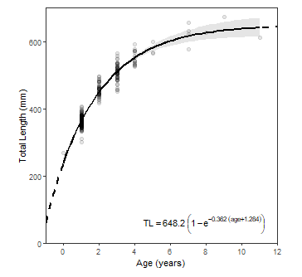
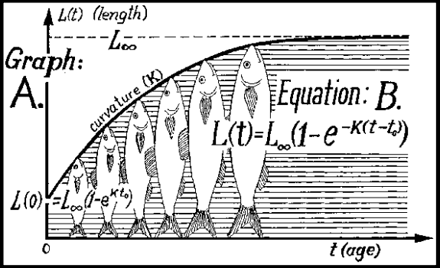
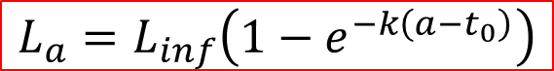
Challenge 1: Individual vs. Biomass
Canadian catch monitoring (dockside, at-sea observer) records weights
Not possible to count most species
The same number of animals increase in biomass during the year
Example: Von Bertalanffy Function
Growth curve to relate changes in length to age
Depends on length at birth (L0), maximum length (Linf) and a growth coefficient (k)
$$L_{a}=L_{inf}\left(1−e^{−k\left(a−t_{0}\right)}\right)$$

Slide 15
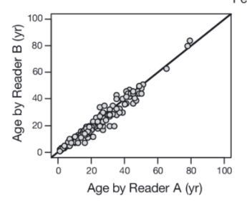
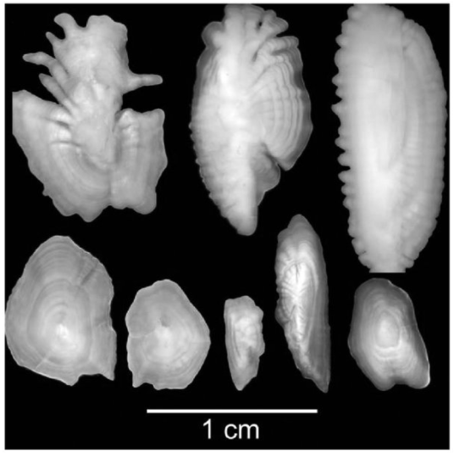
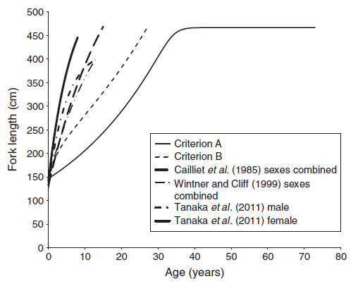
Challenge 2: Age Structure
How well can we approximate fish age?
Requires hard structures
Growth is laid down seasonally
Banding pattern is used to indicate years
For some species, age can be very uncertain
Otolith readings
Comparison of white
shark growth models

Slide 16
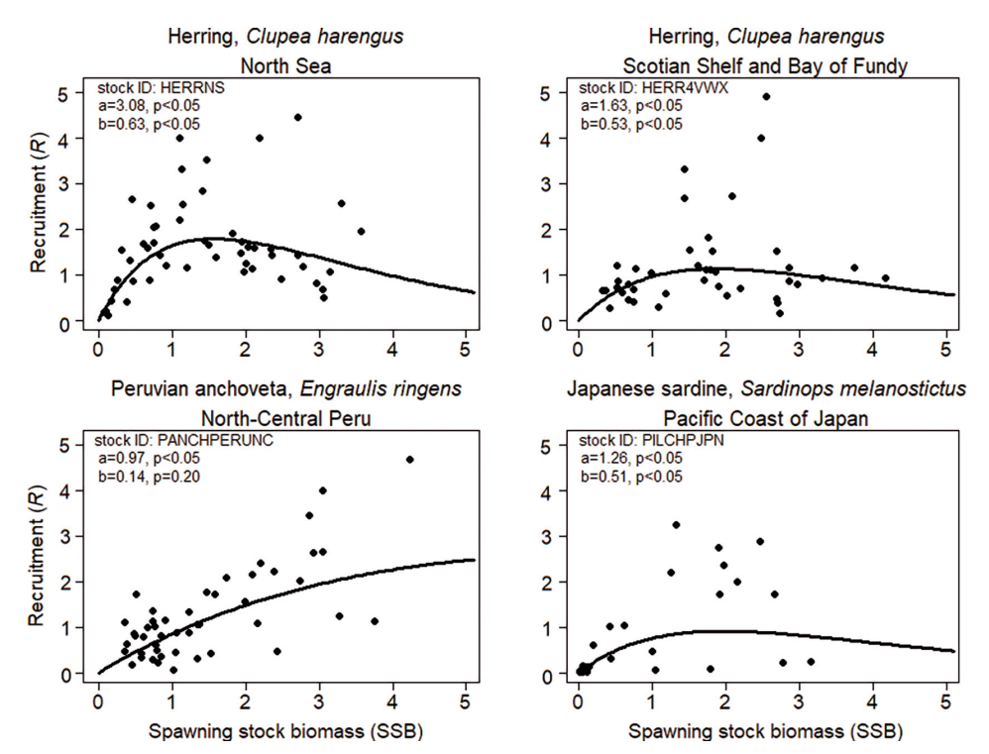
Challenge 3: Estimating S-R
Can’t have recruitment without spawners (intercept has to be zero)
Very hard to determine slope at the origin, shape and the asymptote
Examples: Ricker model to herring
Note the level of variability in R for a specific value for S
Equilibrium is typically assumed
Data is a value from a single year
See different stock sizes
Different recruitment at same stock size
Assuming the function is the same to fit the line

Slide 17
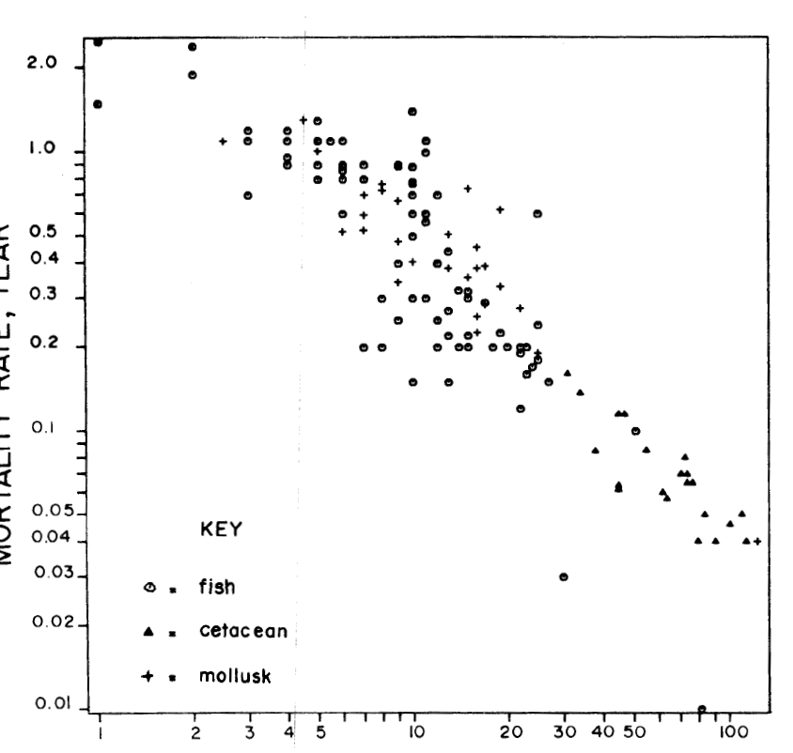
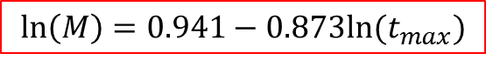
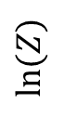
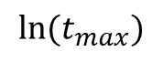
Challenge 4: Natural Mortality
M = 0.2
$$\ln\left(M\right)=0.941−0.873ln⁡(t_{max})$$
Data gives you information on total mortality
Need to partition it into M and F components
How do you determine M?
Estimate it on the basis of longevity?
Set the value at a constant?
Try to model different rates among ages?
Assume that M is tied to environmental conditions?
$$ln⁡(Z)$$
$${ln⁡(t}_{max})$$

Slide 18
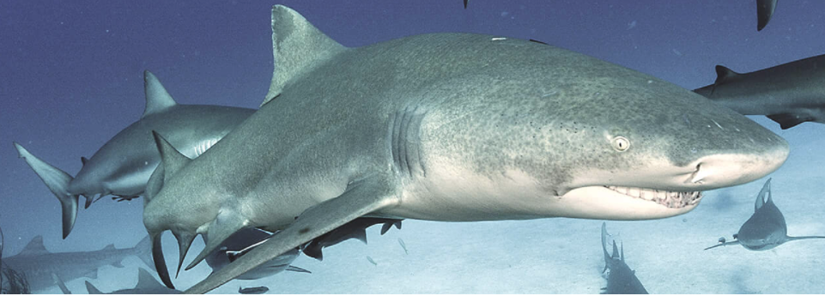
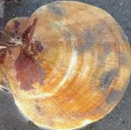
Dusky Scallop Shark
Newly Targeted Species in Maritimes Region.
Interest to develop a fishery, and science advice is required

Slide 19
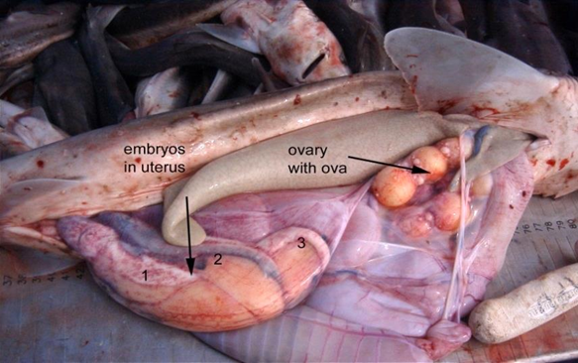
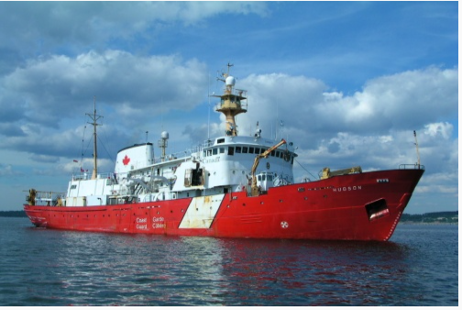
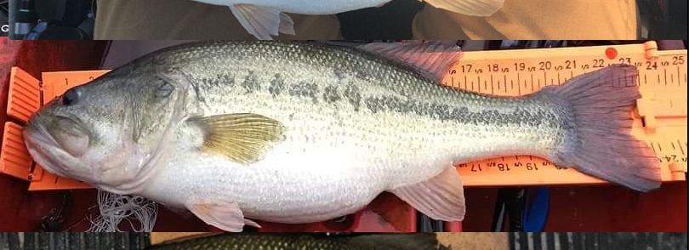
Step 1: Sampling
Life History Data
Scientific Survey
Catch
Growth Data

Slide 20
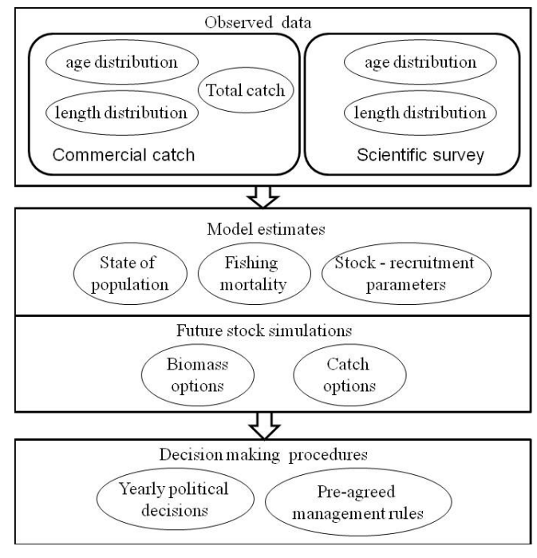
Stock Assessment Flowchart
Exercise 2
Exercise 3
Exercise 1
Kuparinen et al. 2012. Increasing biological realism of fisheries stock assessment: towards hierarchical Bayesian methods. Environ. Rev.
Exercise 4

